Slide 1



Hardware and Software Fundamentals of Intelligent Computing Systems

Slide 2
Lecture 23：Loop-Invariant Code Motion (LICM)

Slide 3
Loop Invariant Code
Code that produces the same result regardless of which loop iteration it runs in
Loop Invariant Code Motion, LICM
Hoisting loop-invariant code outside the loop to reduce the number of executions
Positioned toward the earlier/frontend stage in compilation process
Performance Influence
Before: Execute N times × Time = N × T
After: 1 × T + Execute N times × 0 = T
Save: (N-1) × T
LICM
Source Code
IR
OptimizationPass
Target Code

Slide 4
Loop Invariant Code
Example Code
Hoist the computation of x and y outside the loop.
for (int i = 0; i < n; i++) {
int x = a + b; // Loop-Invariant varaibles: a, b not changed in loop
int y = x c; // Loop-Invariant varaibles: dependent on x
arr[i] = y + i; // Loop-variant：depend on i
}
for ...
x=a+b
y=x*c
use(y)
x=a+b
y=x*c
for ...
use(y)

Slide 5
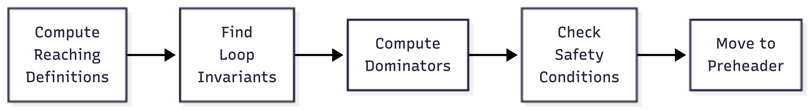
LICM Flow
Compute Reaching Definitions
Find Loop Ivariants
Compute Dominators
Check Safety Conditions
Move to Preheader

Slide 6
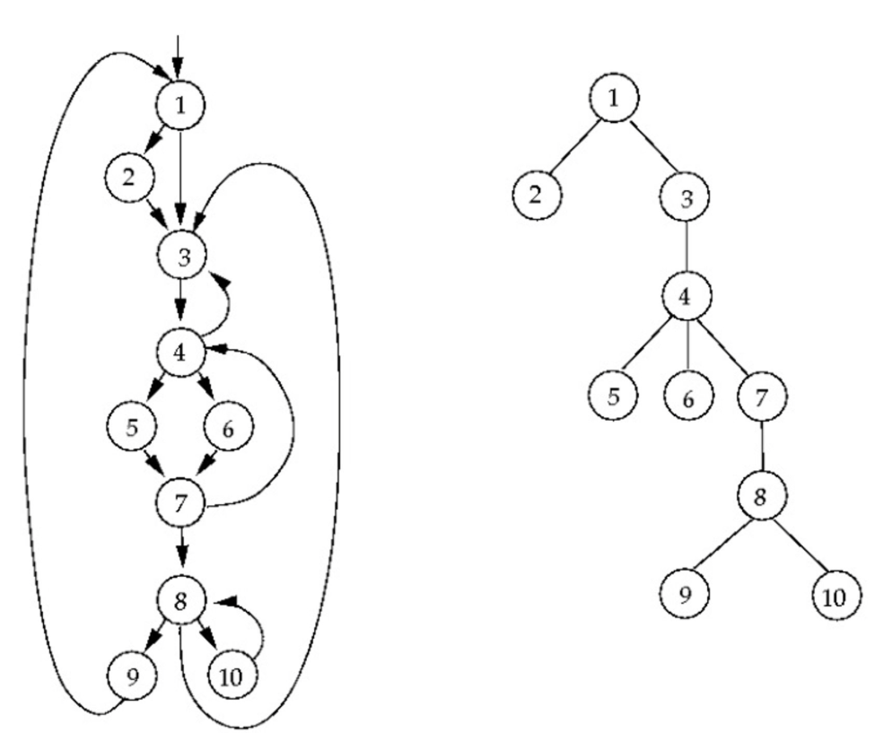
Loop and Domination
Loop Structure
Header
Only entry to the loop, dominating all nodes in loop
Back Edge
Node Jumping back to header
Loop Body
Nodes between header and back edge
Domination
A Dominates B：All path from entry to B must pass A
A Dominates B strictly：A dominates B and A ≠ B
Entry
header
Body
Exit
Back Edge

Slide 7
Loop and Domination
Domination represented in Tree
Parent node dominates all children
LICM use domination to check safety conditions
Lengauer-Tarjan Algorithm
Based on DFS
Semidominator
def compute_dominators(cfg):
# 1. Calculate DFS tree and DFS index
dfs_tree, dfnum = dfs(cfg.entry)
# 2. Calculate semi-dominator
sdom = {}
for v in reverse_dfs_order:
sdom[v] = min(dfnum[u] for u in predecessors(v))
# 3. Calculate dominator from semi-dominant
idom = {}
for v in dfs_order:
idom[v] = compute_idom(v, sdom)
return idom

Slide 8
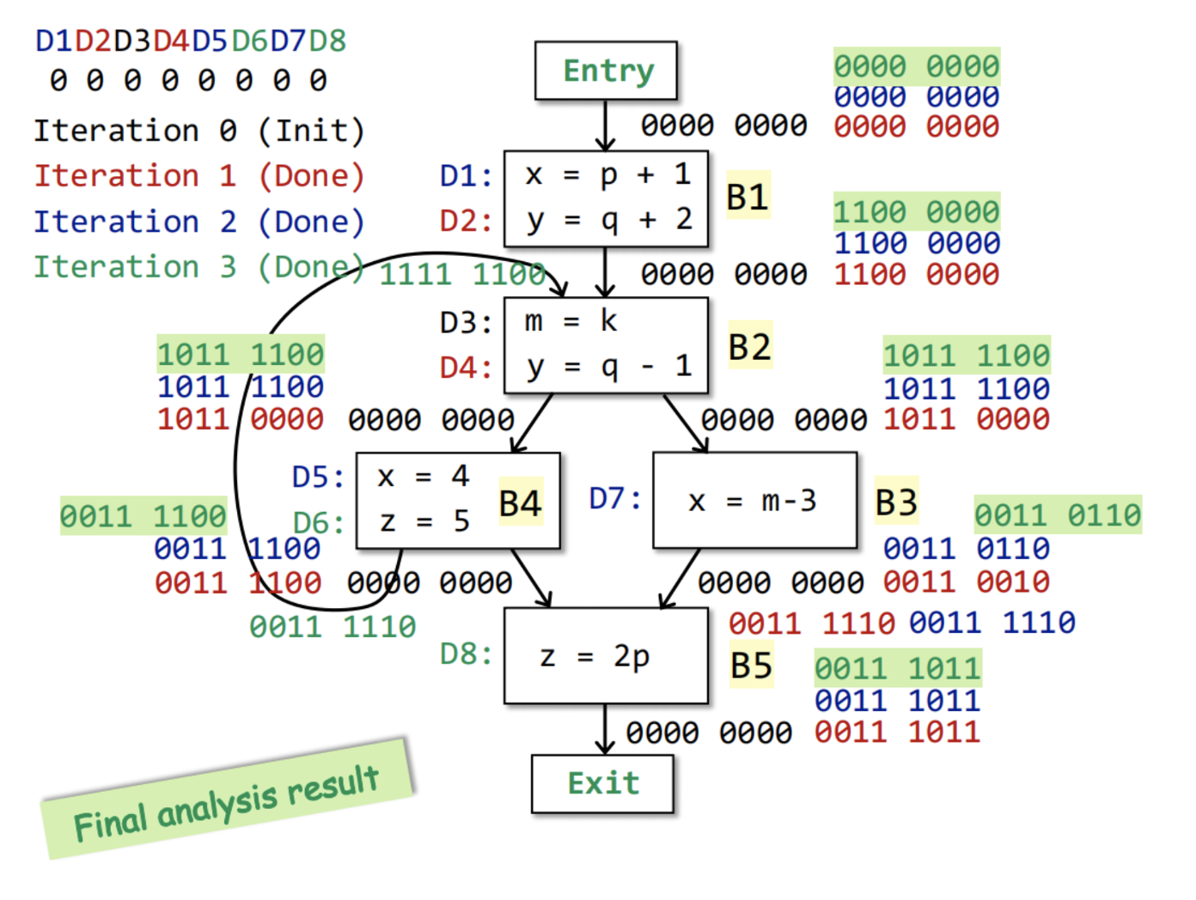
Reaching Definitions
Analyze the variable definitions that may reach each point in the program
IN[B] = ∪(OUT[P]) for all predecessors P of B
OUT[B] = GEN[B] ∪ (IN[B] - KILL[B])
Reaching Definitions in LICM
Determine where operands are defined
Check whether a definition originates from
outside the loop
Detect whether a variable has multiple
definitions

Slide 9
Loop-Invariant Detection Algorithm
Initialization: Mark all instructions whose operands are defined outside the loop as "invariant"
Iterate until a fixed point is reached：
For each instruction I: "x = y op z" inside the loop:
If any of the following conditions are met, mark it as "invariant":
1. All reaching definitions of y are outside the loop, or
2. There is exactly one reaching definition, and
that definition is loop-invariant
And: z satisfies the same conditions (if applicable)
def find_loop_invariants(loop):
invariant = set()
changed = True
while changed:
changed = False
for instr in loop.instructions:
if is_invariant(instr, invariant):
if instr not in invariant:
invariant.add(instr)
changed = True
return invariant

Slide 10
Loop-Invariant Detection Algorithm Example
Initialization
Iterate
Round 1: {x = a+b} → INVARIANT
Round 2: {y = x*c} → INVARIANT
Round 3: No newly added → Fixed Point
Final Invariant Set: {x = a+b, y = x*c}
// a, b, c defined outside the loop
for (int i = 0; i < n; i++) {
x = a + b;
// It 1：Invariable (a,b defined outside)
y = x c;
// It 2：Invariable (x invariable, c defined outside)
z = y + i;
// Variable (depend on i)
w = z 2;
// Variable (depend on z)
}

Slide 11
Dependence Type
Input Dependence
Loop-Carried Dependence
Cannot apply LICM
True/Flow Dependence
Anti Dependence
Output Dependence
S1: x = ...
S2: ... = x // S2 depends on S1
S1: ... = x
S2: ... = x // can be executed in parallel
S1: ... = x
S2: x = ... // S2 executed after S1
for (i = 1; i < n; i++) {
a[i] = a[i-1] + 1;
// Loop-carried: a[i] ← a[i-1]
}
S1: x = ...
S2: x = ... // maintain write sequence

Slide 12
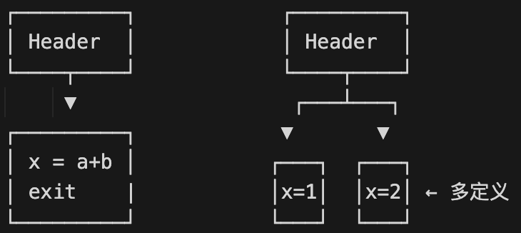
Safety Conditions for Code Motion
Dominate All Exits
Instruction's basic block must dominate all exits of the loop
Guarantees the instruction will always be executed
Unique Definition
The variable has only this one definition within the loop
Avoids conflicts with other definitions
Dominate All Uses
The definition dominates all uses of the variable within the loop
Or: this is the only definition that reaches the use points
Feasible
Infeasible

Slide 13
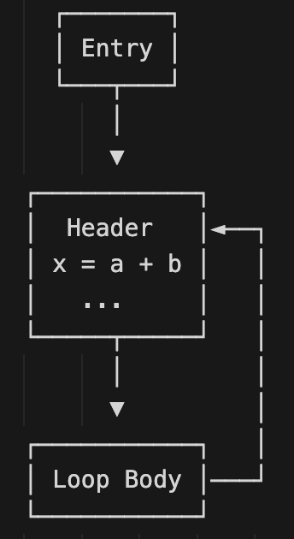
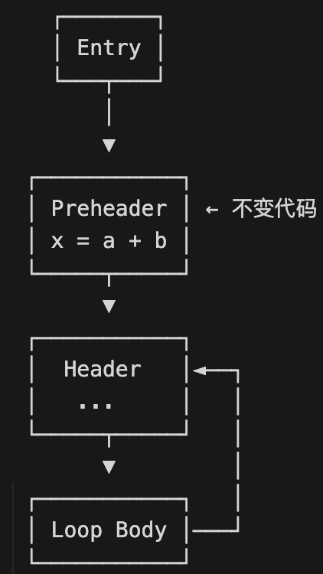
Preheader
A special basic block placed
before the loop entry
Has exactly one successor (i.e., the header)
The location where loop-invariant code is placed
LICM Pseudo Code
LICM
candidates = []
for instr in invariants:
if dominates_all_exits(instr.block, exits) and \
is_only_definition(instr) and \
dominates_all_uses(instr):
candidates.append(instr)
# Move to preheader based on dependency
for instr in topological_sort(candidates):
move_to_preheader(instr, loop.preheader)

Slide 14
LICM in LLVM
lib/Transforms/Scalar/LICM.cpp
Loop-Invariant Code Motion
Hoisting memory accesses into registers
Sinking code to loop exits
LoopInfo Analysis
LoopInfo &LI = getAnalysis<LoopInfoWrapperPass>().getLoopInfo();
DominatorTree for Dominance Analysis
DominatorTree &DT = getAnalysis<DominatorTreeWrapperPass>().getDomTree();
AliasAnalysis for Mameory Operation Analysis
AliasAnalysis &AA = getAnalysis<AAResultsWrapperPass>().getAAResults();

Slide 15
Special Handling of Memory Operations
Memory operations may have side effects
Must-Alias Analysis: Identify pointers that definitively point to the same memory location
Scalar Promotion: Lift memory operations within the loop into scalar operations
参考https://llvm.gnu.ac.cn/docs/AliasAnalysis.html
for (int i = 0; i < n; i++) {
*p = p + arr[i]; // Each iteration read and writes*p
}
int temp = p; // Read outside the loop
for (int i = 0; i < n; i++) {
temp = temp + arr[i]; // Scalar operation
}
p = temp; // Write back outside the loop

Slide 16
Loop Optimization in Triton
Triton Compilation Flow
Triton Python → Triton IR (TTIR) → TritonGPU IR → LLVM IR → PTX/CUBIN
General Optimization Methods
Loop Pipelining: Software Pipeline, Latency Hiding
Loop Unrolling: Loop unrolling, Reduce Control Cost
LICM generally carried on at TTIR and TritonGPU IR
Based on MLIR
Reuse MLIR Analysis Pass
Optimize at different abstract levels

Slide 17
Triton Loop Structure Example
Matrix Multiplication
Optimization Opportunities
Base address of pointer might be loop invariant
stride calculation is usually loop invariant
@triton.jit
def matmul_kernel(A, B, C, M, N, K, ...):
# Initialize Accumulator
acc = tl.zeros((BLOCK_M, BLOCK_N), dtype=tl.float32)
# Main loop - K-dimension iteration
for k in range(0, K, BLOCK_K):
# Load blocks of A, B
a = tl.load(A_ptr + k stride_ak)
# Possible Loop Invariant
b = tl.load(B_ptr + k stride_bk)
acc += tl.dot(a, b)
# Store result
tl.store(C_ptr, acc)

Slide 18
LICM in MLIR
Refere to mlir/lib/Transforms/LoopInvariantCodeMotion.cpp
void LoopInvariantCodeMotion::runOnOperation() {
LoopLikeOpInterface loopOp =
getOperation()->getParentOfType<LoopLikeOpInterface>();
// Collect loop invariant operations
SmallVector<Operation> invariantOps;
for (Operation &op : loopOp.getLoopBody().getOps()) {
if (isLoopInvariant(&op, loopOp))
invariantOps.push_back(&op);
}
// Move to preheader
for (Operation op : invariantOps) {
op->moveBefore(loopOp);
}
}

Slide 19
Limitation and Improvements of LICM
Limitations
Exception Handling: Moving code that may throw exceptions
Speculative Execution: If the loop may not execute, moving code could introduce additional overhead
Memory Side Effects: Complex memory aliasing relationships are difficult to analyze
Improvements:
Loop Unswitching: Move conditional checks inside the loop to outside the loop
Loop Versioning: Create multiple versions of the loop to enable further optimizations
Speculative LICM: Perform speculative hoisting when provably safe

Slide 20

The Solution: FlagOS, a Unified AI Software Stack

Slide 21








https://space.bilibili.com/3546791834290849
https://github.com/flagos-ai
https://www.zhihu.com/people/95-22-20-18/posts
https://flagos.io/Home

Slide 22

Thanks for your time！

